Slide 1


Banking System
(User Manual)
By:
Sufiyaan Usmani
Qasim Hasan
Ahsan Ashraf
Talha Shaikh

Slide 2
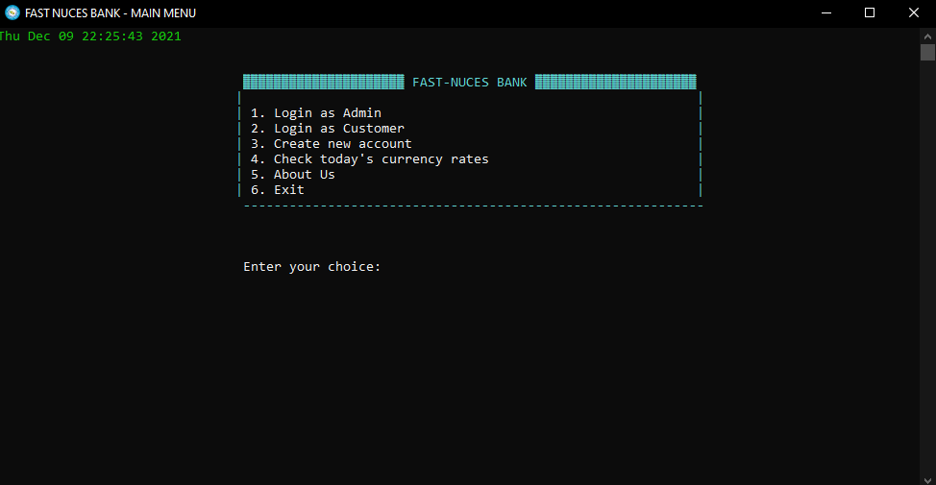
Main Menu

Slide 3
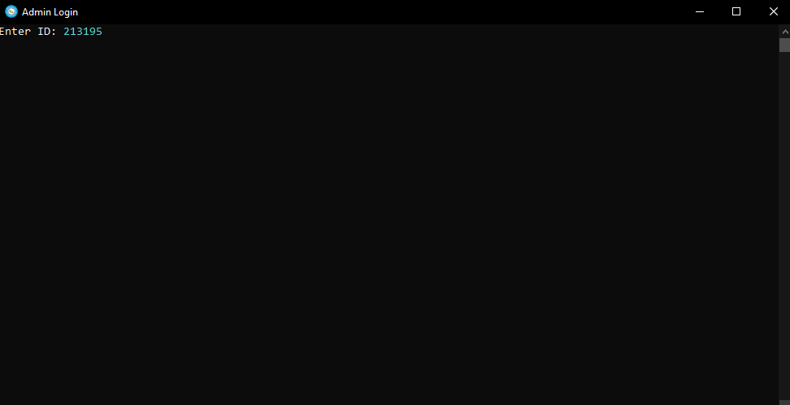
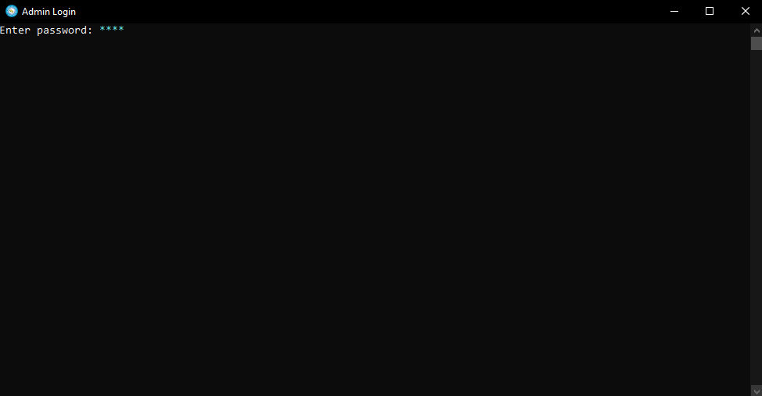
1. Login As Admin
Admin must have created a account(.admin file)
Password:
8 length of password in required when logging in
Enter ID:

Slide 4
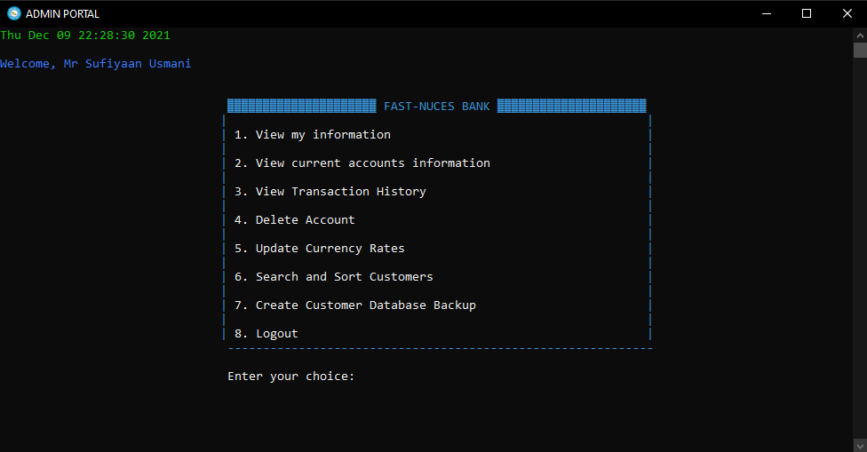
Admin Portal

Slide 5
2. Login As Customer
Enter Account Number:
Customer must have created an account before hand to login in
Password:
8 length password are accepted

Slide 6
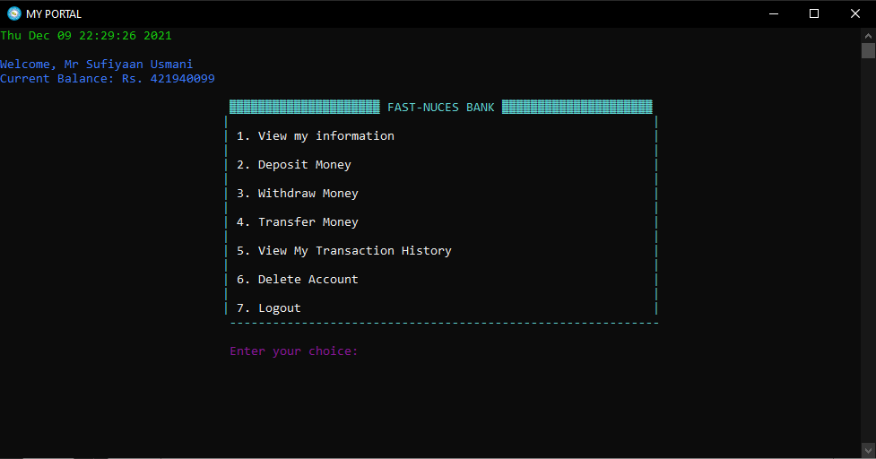

Slide 7
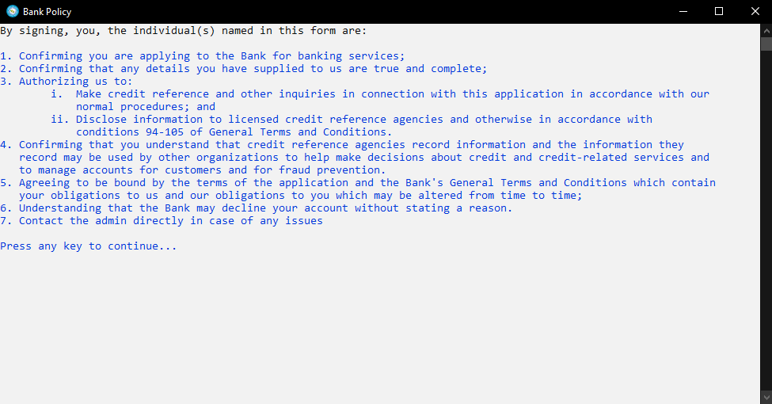
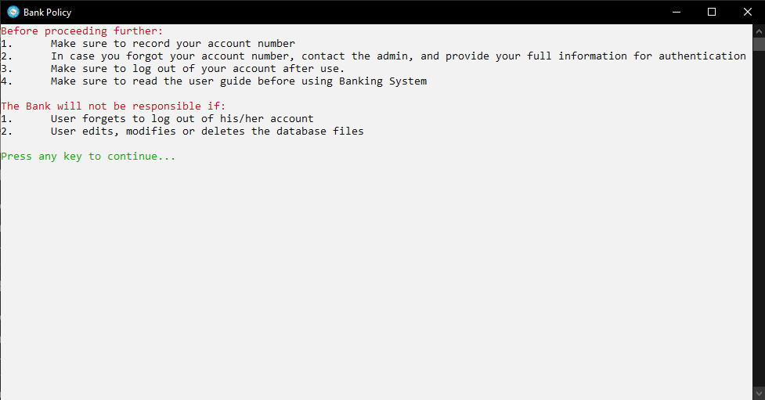
3. Create New Account

Slide 8
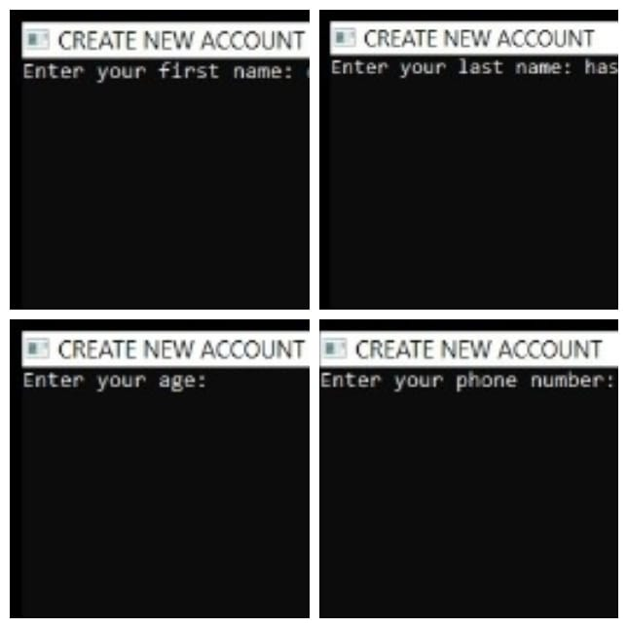
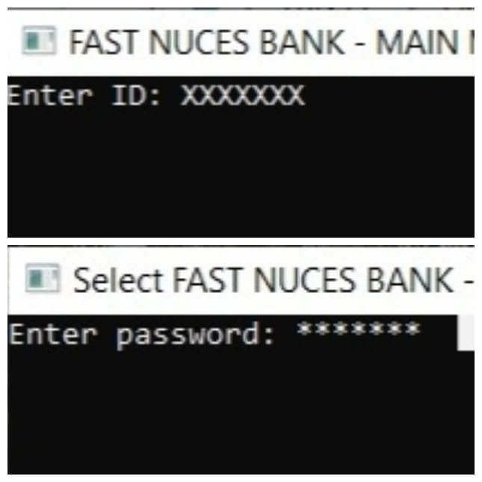
Enter your first Name:XXXXX
It will be saved in .customer file
Enter your last Name:XXXXX
It will also be saved in .customer file
Enter your age:
Extra information for verification
Enter your phonenumber:XXXXXXXXX
Extra information taken for verification
This data will be saved in .customer file

Slide 9
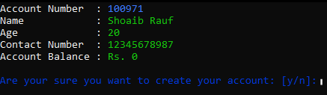

Slide 10
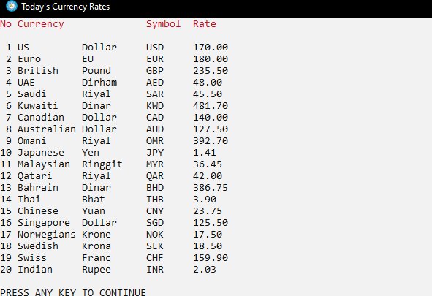
4. Check Today’s Currency Rates

Slide 11
Bank Policy
By signing, you, the individual(s) named in this form are:
1. Confirming you are applying to the Bank for banking services;
2. Confirming that any details you have supplied to us are true and complete;
3. Authorizing us to:
i. Make credit reference and other inquiries in connection with this application in accordance with our
normal procedures; and
ii. Disclose information to licensed credit reference agencies and otherwise in accordance with
conditions 94-105 of General Terms and Conditions.
4. Confirming that you understand that credit reference agencies record information and the information they
record may be used by other organizations to help make decisions about credit and credit-related services and
to manage accounts for customers and for fraud prevention.
5. Agreeing to be bound by the terms of the application and the Bank's General Terms and Conditions which contain
your obligations to us and our obligations to you which may be altered from time to time;
6. Understanding that the Bank may decline your account without stating a reason.
7. Contact the admin directly in case of any issues
Before proceeding further:
1. Make sure to record your account number
2. In case you forgot your account number, contact the admin, and provide your full information for authentication
3. Make sure to log out of your account after use.
4. Make sure to read the user guide before using Banking System
The Bank will not be responsible if:
1. User forgets to log out of his/her account
2. User edits, modifies or deletes the database files

Slide 12
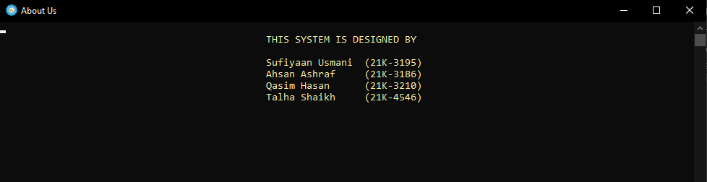
5. About Us

